Slide 1
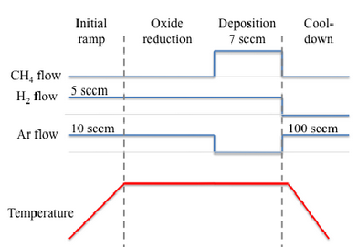
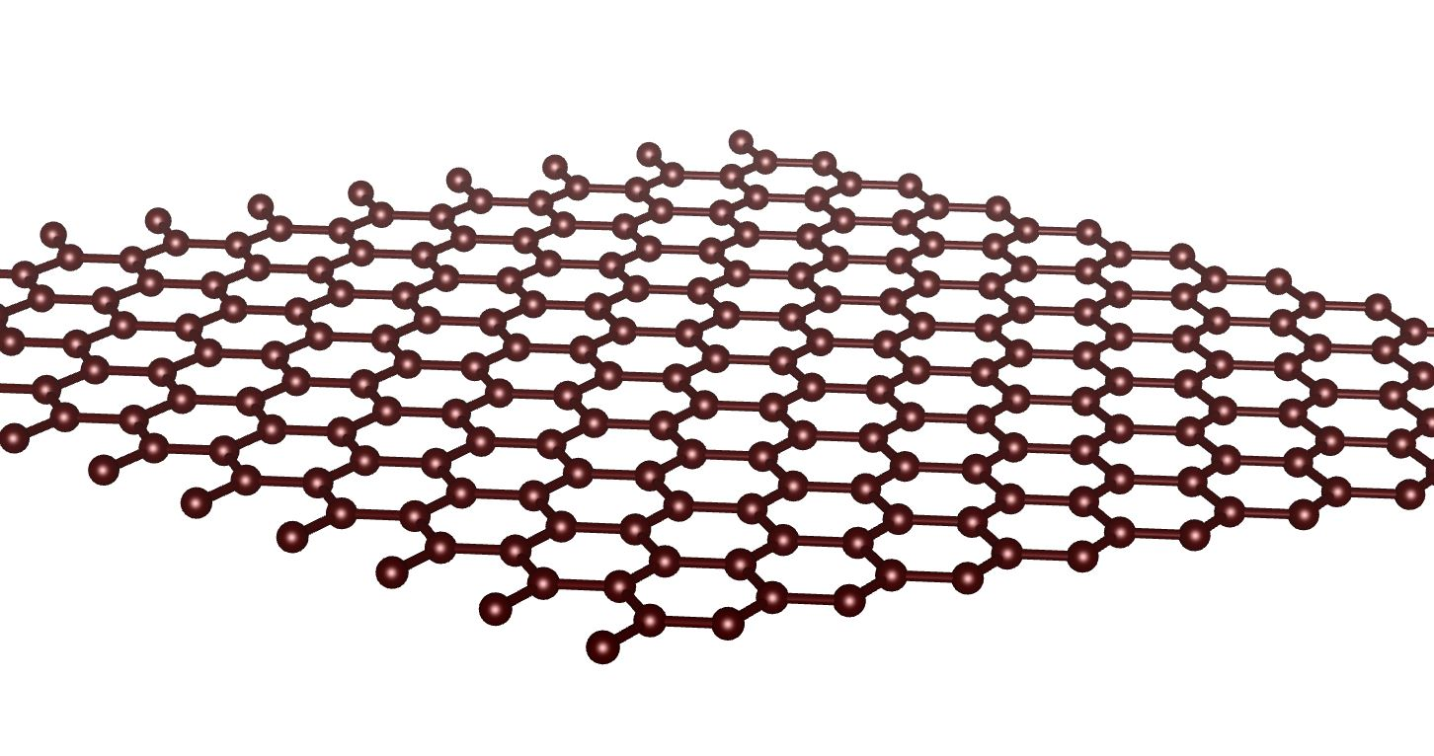
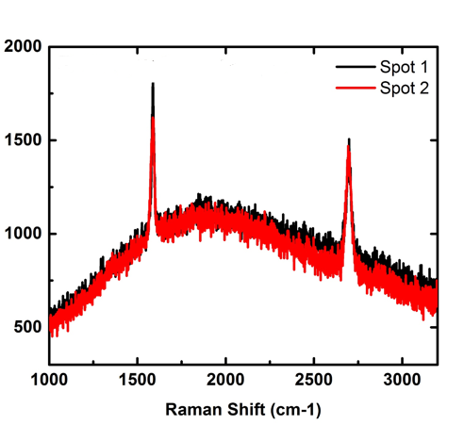
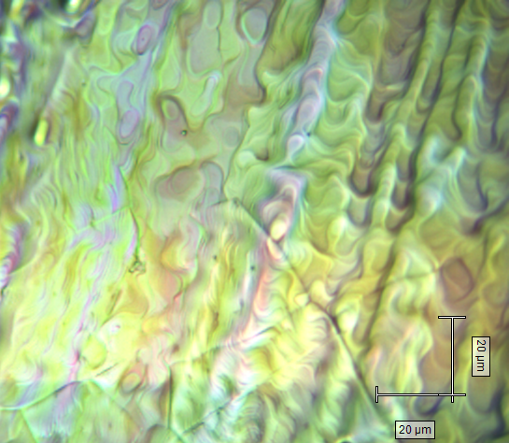
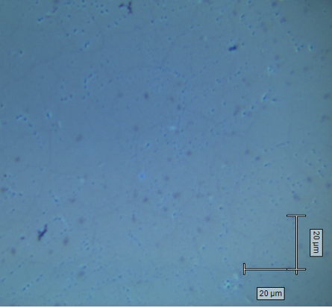
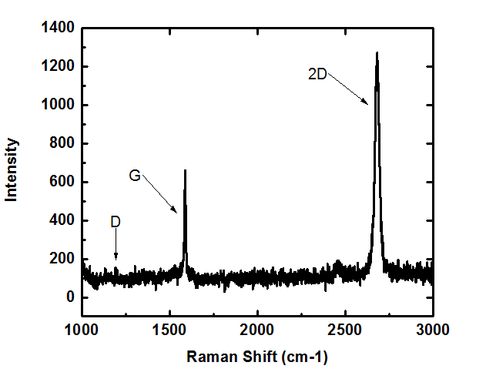
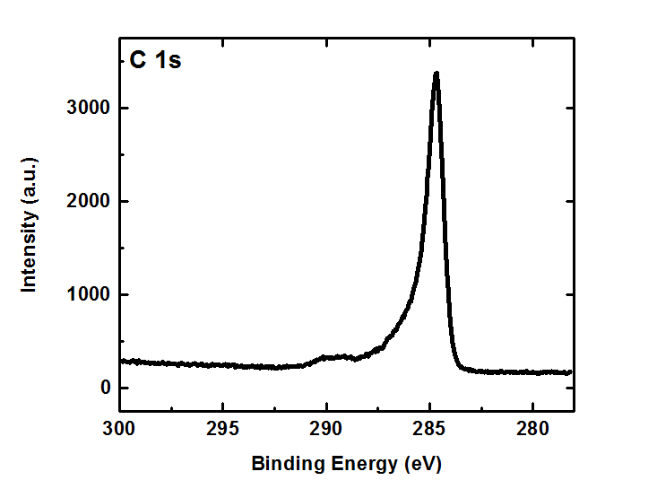
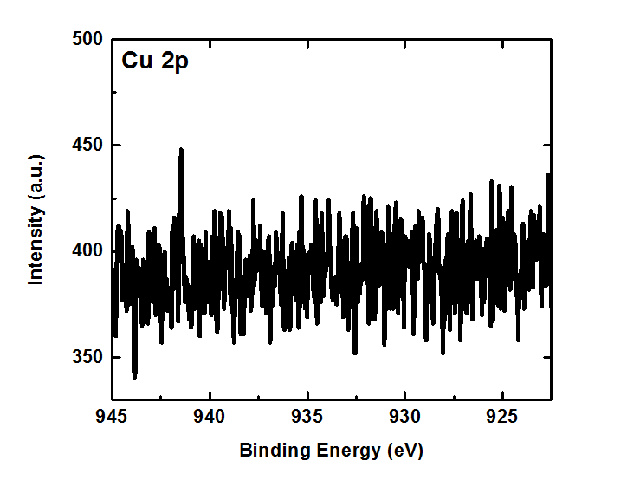
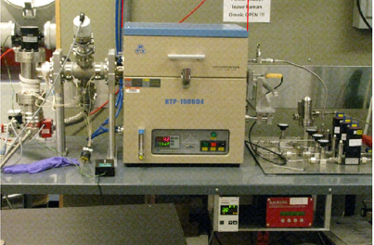
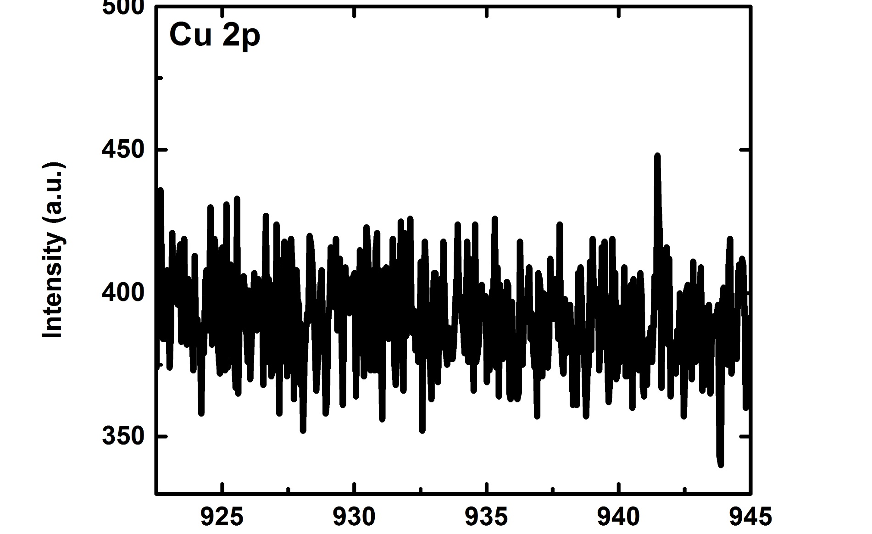
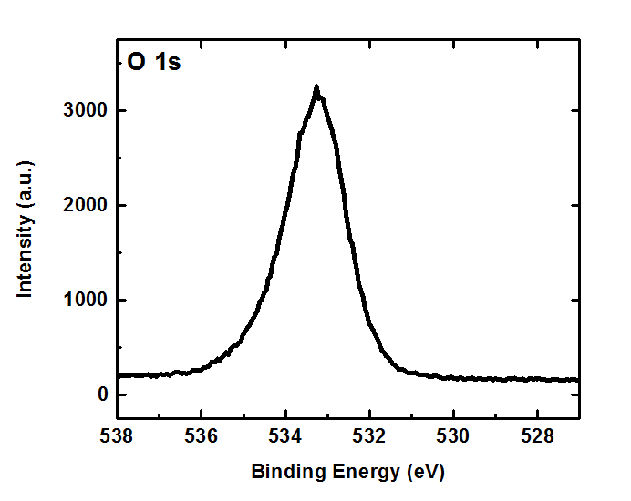
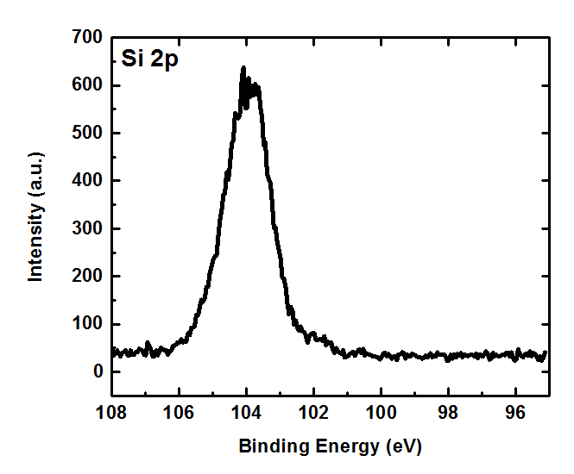
Fabrication and Characterization of CVD Graphene
Zeyan Xu, Angelica Azcatl, Stephen McDonnell, Robert M. Wallace*
Department of Material Science and Engineering, University of Texas at Dallas
Introduction
Results / Characterization Methods
Conclusions / Future Work
Single layer graphene is a 2-Dimensional honeycomb lattice of sp²-hybridized carbon atoms. The structure is shown below:
Raman Result
In conclusion, we have successfully fabricated monolayer graphene film via CVD method and transferred it onto SiO₂ on silicon.
The optical image of graphene on SiO₂ on silicon shows minimal tears and defects on the surface. The Raman spectrum obtained shows no D peak and the ratio of FWHMs of the G and 2D peak indicates we have monolayer graphene.
XPS results provide consistent evidence of good quality graphene: there is no copper present after the transfer, the C, O, Si peaks are present as they are the only elements that constitute the sample.
Now that we demonstrated that we are able to make good quality monolayer graphene, we will develop projects to better understand its various properties and we hope to integrate it into semiconductor devices in the future.
Ever since the pioneering work of K. S. Novoselov and A. K. Geim to mechanically exfoliate graphene with scotch tape in 2004,^{[1]} (this was later awarded the Nobel Physics Prize in 2010)
Graphene on copper substrate:
graphene has gained a significant amount of attention amongst scientists all over the world for its novel electrical, mechanical, chemical properties. For example, in the semiconductor industry, graphene is a desirable material due to its unique ballistic electron transport feature.
In this project, we aim to fabricate high quality monolayer graphene. We also transfer them onto arbitrary substrates and will integrate it into semiconductor devices in the future. The fabrication technique we used was chemical vapor deposition (CVD). Compared with other methods, CVD exhibits evident advantages such as CMOS compatibility, excellent electrical quality, etc.^{[2]} We used copper substrate for CVD growth, and then we used Raman spectroscopy to examine its quality. We then applied an elaborate transfer process to transfer the graphene from copper substrate onto silicon (Si) wafer with a thin layer of silicon dioxide (SiO₂) at the surface. We use Si as the desired substrate because it is the most common substrate used in the semiconductor industry. After transfer, we use Raman spectroscopy and X-ray photoelectron spectroscopy (XPS) to characterize its chemical properties.
Figure: Growth schematic
The above figure shows the precursors used during growth and how much each of them is used. The growth temperature reaches 1035°C. The total deposition time is optimized at 4 minutes and the overall growth time is less than 1 hour.
Here, the carbon atoms in CH₄ gas are the responsible components for the composition of graphene. H₂ is used to act as an activator of the surface bound carbon and an etching reagent that controls the size of graphene domains.^{[3]} Argon is an inert gas and is used to suppress any harmful reaction which may be caused by hydrogen gas.
Graphene on SiO₂ on silicon:
References
[1] Electric Field Effect in Atomically Thin Carbon Films
K. S. Novoselov, A. K. Geim, S. V. Morozov, D. Jiang, Y. Zhang, S. V. Dubonos, I. V. Grigorieva, and A. A. Firsov
Science 22 October 2004: 306 (5696), 666-669.
DOI:10.1126/science.1102896
[2] Graphene Growth and Device Integration
Colombo, L.; Wallace, R.M.; Ruoff, R.S.,
Proceedings of the IEEE , vol.101, no.7, pp.1536,1556, July 2013
DOI: 10.1109/JPROC.2013.2260114
[3] Role of Hydrogen in Chemical Vapor Deposition Growth of Large Single-Crystal Graphene
Ivan Vlassiouk, Murari Regmi, Pasquale Fulvio, Sheng Dai, Panos Datskos, Gyula Eres, and Sergei Smirnov
ACS Nano 2011 5 (7), 6069-6076
DOI: 10.1021/nn201978y
[4] The effect of chemical residues on the physical and electrical properties of chemical vapor deposited graphene transferred to SiO₂
Pirkle, A. and Chan, J. and Venugopal, A. and Hinojos, D. and Magnuson, C. W. and McDonnell, S. and Colombo, L. and Vogel, E. M. and Ruoff, R. S. and Wallace, R. M.,
Applied Physics Letters, 99, 122108 (2011),
DOI: http://dx.doi.org/10.1063/1.3643444
Spin coat PMMA
Nitric Acid Baths (or oxygen plasma etching)
Ammonium persulfate bath
Transfer onto Si wafer
Rinse with IPA
Acetone bath
Heat to 220°C
Transfer Mechanism
Fabrication Methods
XPS Result
Growth Mechanism
XPS carried out on graphene on SiO₂ on silicon sample:
Copper surface pretreatment schematic:
Acetic Acid
Nitric Acid
Acetic Acid
The pretreatment is done to remove copper oxides on the surface before the actual growth process to improve the quality of grown graphene.
C 1s peak from graphene no copper present
A multi-step process is implemented to transfer the graphene from copper substrate to Si wafer.
PMMA is used to protect the graphene layer from etching during the transfer process;
Nitric acid baths are used to etch away the graphene grown on the backside of copper;
Ammonium persulfate baths are used to remove copper, after this step the film becomes transparent;
Acetone bath is used to remove the PMMA that we spin coated in step 1.
Acknowledgements
The authors would like to acknowledge the UTD Undergraduate Research Program and the Erik Jonsson Distinguished Chair for support.
Authors to whom correspondence should be addressed.
Electronic address: rmwallace@utdallas.edu
Figure: CVD Furnace
O 1s peak from SiO₂ Si 2p peak from SiO₂ and silicon

