Slide 1
Fabrication and Characterization of Graphene Micro-structures for Plasmonic Applications
By: Zeyan (Emma) Xu
School of Physics, Georgia Institute of Technology
Advisor: Dr. Zhigang Jiang
Date: 7/31/2014

Slide 2
Overview
Research Objective
Background
  Graphene ● Methods to Make Graphene ● Plasmon ● Cyclotron Resonance
Methodology
  CVD Graphene ● Raman Spectroscopy ● Photolithography ● Infrared Spectroscopy ● Experiment Setup
Results
Conclusion
Acknowledgements
Bibliography

Slide 3
Research Objective
plasmon cross-talk effect plays an important rule in investigating the plasmon energy of graphene nano-structures. In this project, we aim to better understand the plasmon cross-talk effect by doing magneto infrared spectroscopy.

Slide 4
Background
Graphene ● Methods to make graphene ● Plasmon ● Cyclotron Resonance

Slide 5
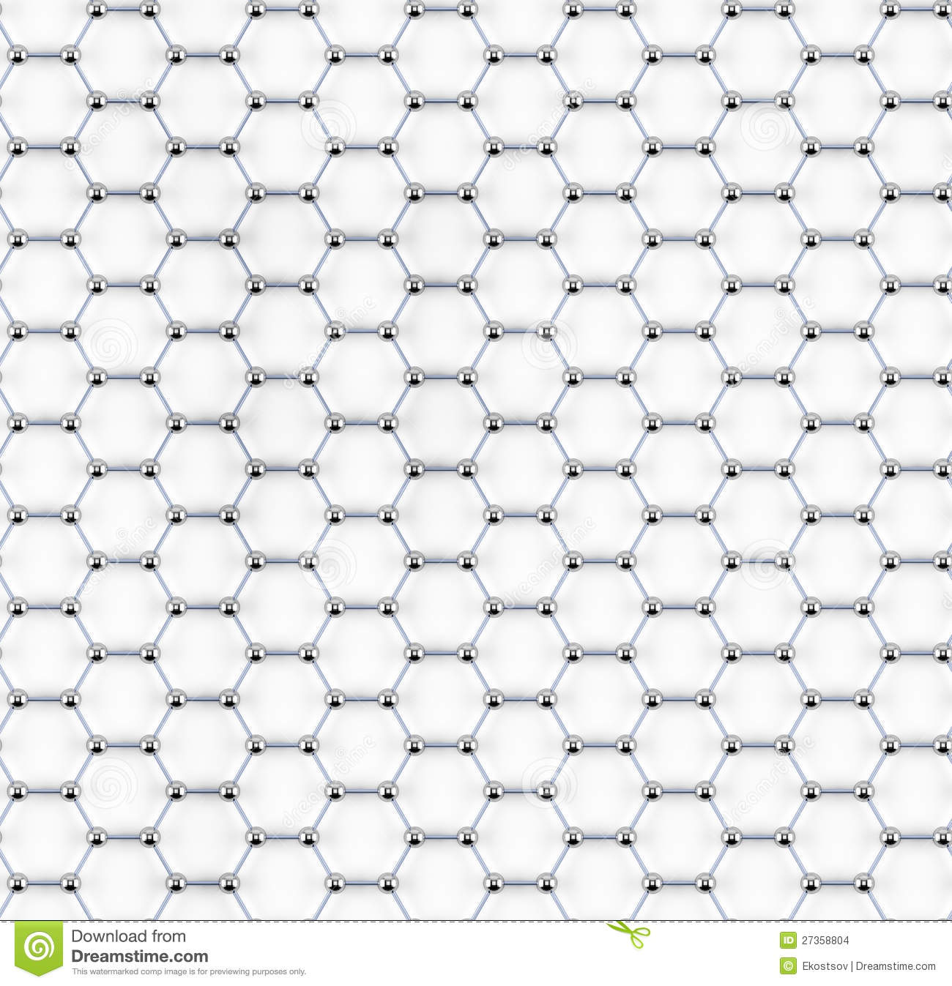
Graphene
2D single layer carbon atoms in honeycomb lattice
Extraordinary mechanical, chemical, and physical properties

Slide 6
Methods to Make Graphene
A few ways to make graphene including:
  CVD (chemical vapor deposition)*
  Mechanical exfoliation
  Epitaxial graphene growing on SiC substrate
  Precipitation from metals

Slide 7
Plasmon
Quasi-particle (not an elementary particle!)
Collective excitation of electronic material
These electronic ripples behave like water ripples
Coulomb interactions are responsible for the initiating of the electronics waves

Slide 8
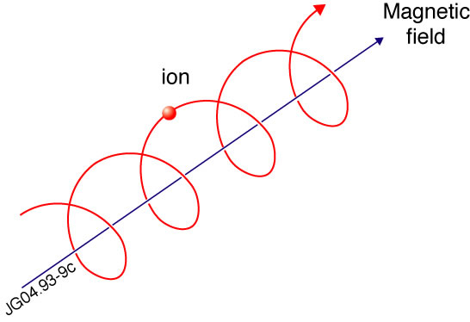
Cyclotron Resonance
An electron in a static and uniform magnetic field will move in a circle due to the Lorentz force.

Slide 9
Methodology
CVD Graphene ● Raman Spectroscopy ● Photolithography ●
Infrared Spectroscopy ● Experiment Setup

Slide 10
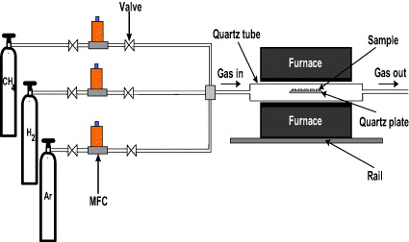
CVD Graphene
CH4 – provide carbon atoms
H2 – catalyst for the reaction
Ar – inert, fill the tube

Slide 11
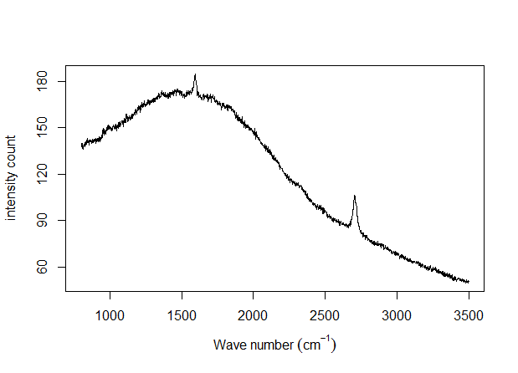
Raman Spectroscopy
Used to determine the quality of Graphene
Theory: Raman scattering. When a light shines on the sample, the light will scatter at a different wavelength and the difference is determined by the crystal structure. thus, we are able to check the purity of the sample.

Slide 12
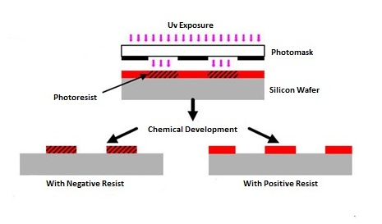
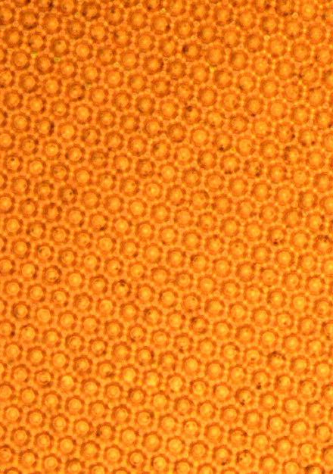
Photolithography

Slide 13
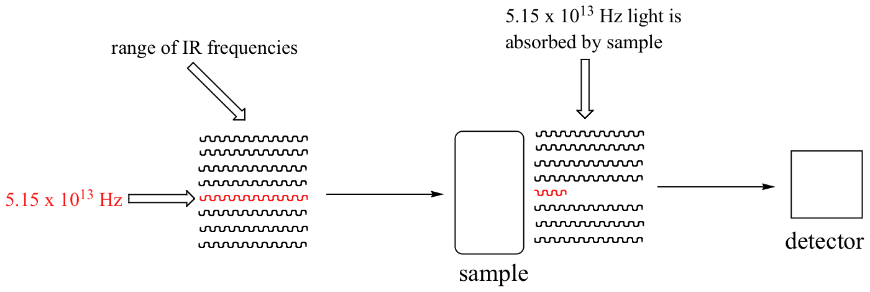
Infrared Spectroscopy
IR: longer wavelength than visible light
Theory: different molecules absorb lights of different frequencies

Slide 14
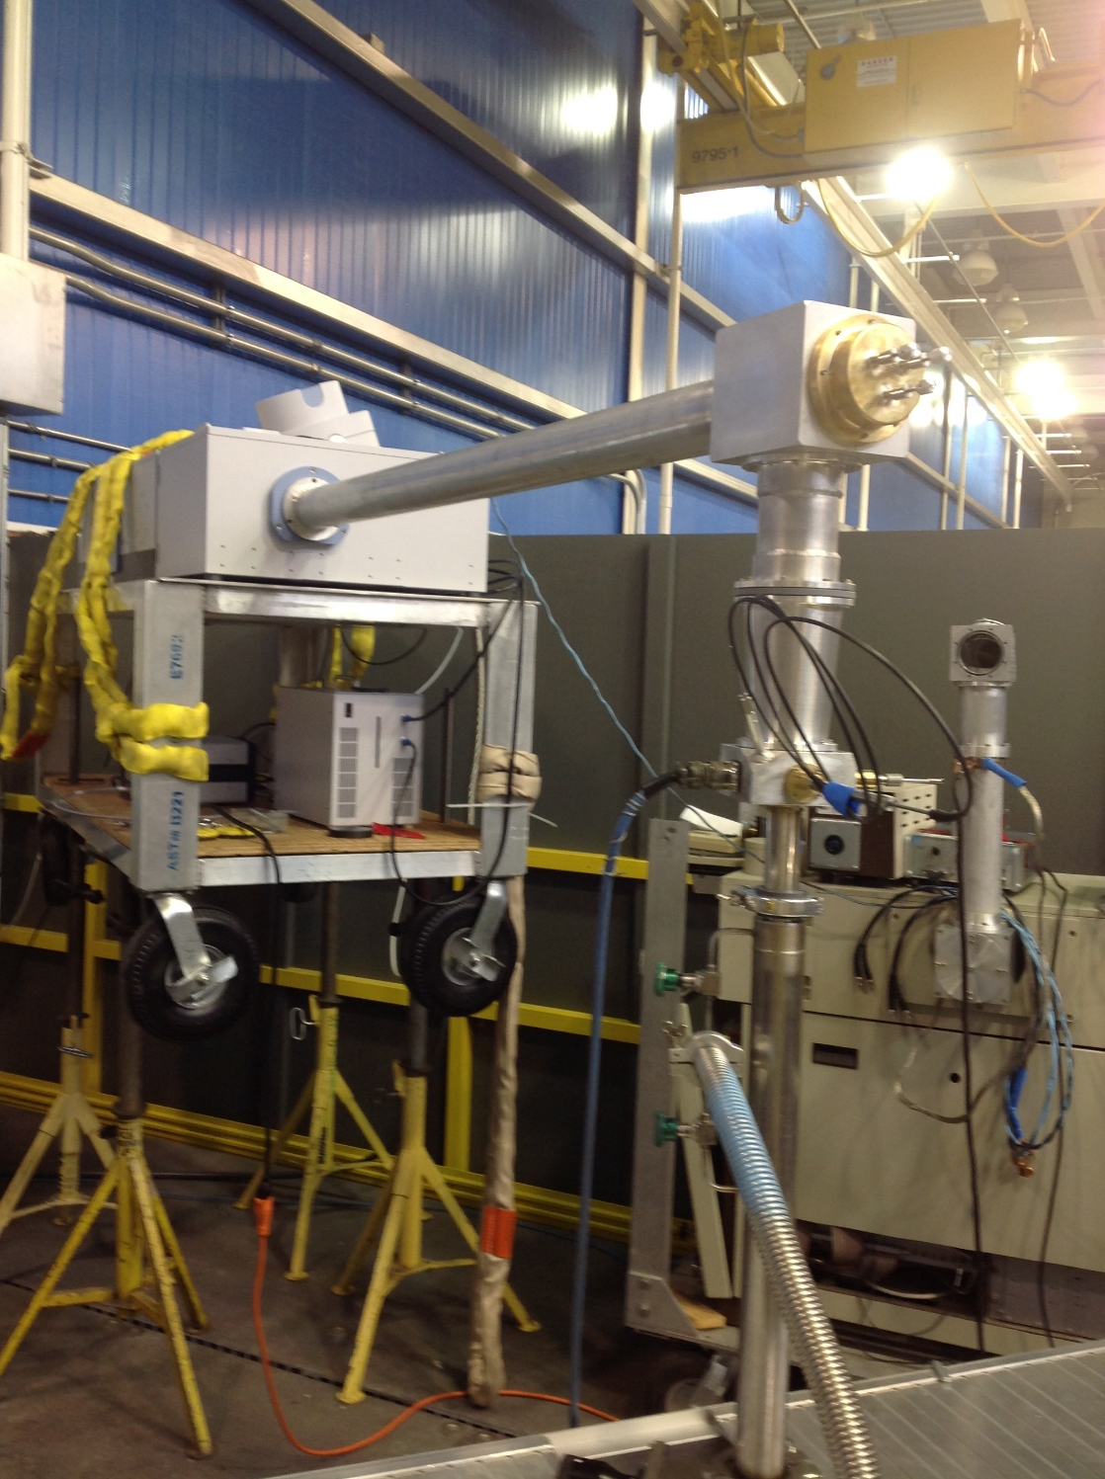

Experiment Setup

Slide 15
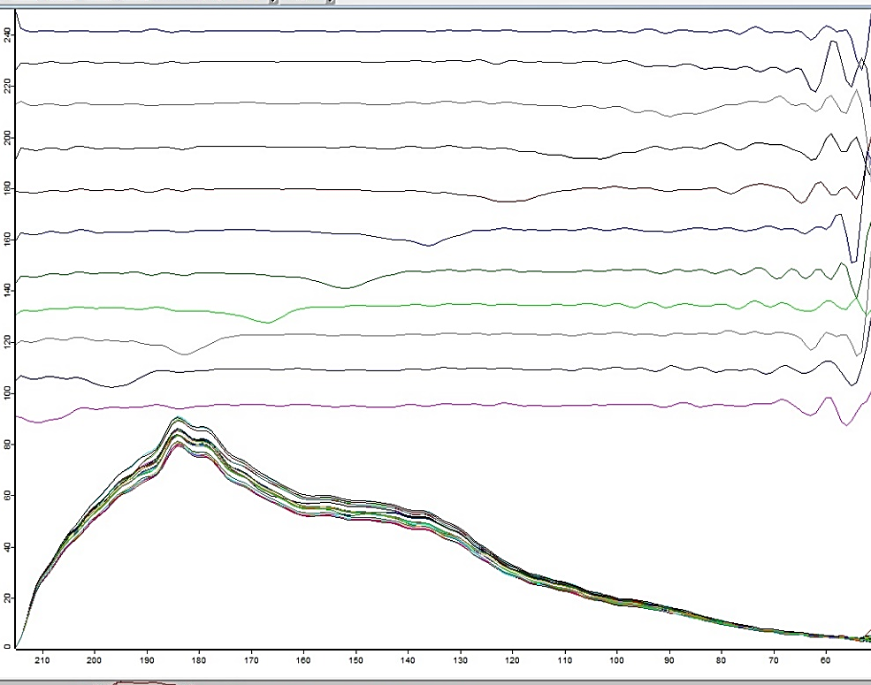
Results
X-axis: wavenumber
Y-axis: transmittance

Slide 16
Conclusions
The cyclotron resonance is due to the frequency of the IR light resonant with Landau Level (Landau Level: the quantization of the cyclotron orbits of charged particles in magnetic fields.)
Linearity of the distance between each dip indicates a linear band structure of the material, and that the peak of transmittance is positively correlated with the square root of B (magnetic field).
Having observed cyclotron resonance builds a platform for better understanding plasmon energy and the plasmon cross-talk effect.

Slide 17
Acknowledgements
This material is based upon work supported by the National Science Foundation under Grant No. DMR 0820382
MRSEC Program: Dr. Leyla Conrad
Faculty Advisor: Dr. Zhigang Jiang
Graduate Students:
  Yuxuan Jiang
  Xunchi Chen
  Wenlong Yu
  Owen Vail
NHMFL Advisor: Dr. Dmitry Smirnov

Slide 18
Bibliography
http://ej.iop.org/images/2043-6262/3/2/025011/Full/ansn429483fig2.jpg
L. Colombo, R. M. Wallace and R.S. Ruoff, "Graphene Growth and Device Integration," (Invited) Proceedings of the IEEE, 101, 1536 (2013). http://dx.doi.org/10.1109/JPROC.2013.2260114
http://www.ims.ut.ee/~alar/microtech/Ch1_4/Figure1_4_1.png
http://chemwiki.ucdavis.edu/@api/deki/files/5040/image011.png?revision=1
Landau, L. D.; and Lifschitz, E. M.; (1977). Quantum Mechanics: Non-relativistic Theory. Course of Theoretical Physics. Vol. 3 (3rd ed. London: Pergamon Press). ISBN 0750635398 .

Slide 19
Bibliography
Paula, Peter Atkins, Julio de (2009). Elements of physical chemistry (5th ed. ed.). Oxford: Oxford U.P. p. 459. ISBN 978-0-19-922672-6.
http://nanoscale.blogspot.com/2009/02/what-is-plasmon.html
http://www.efda.org/wpcms/wp-content/uploads/2011/07/cyclotron.jpg
http://thumbs.dreamstime.com/z/tiled-graphene-sheet-model-27358804.jpg
http://www.lifesci.boun.edu.tr/files/80_a15.jpg
http://web.mit.edu/fbml/winterschool2008/images/NHMFL_LOGO.png

Slide 20
Questions?

