Slide 1


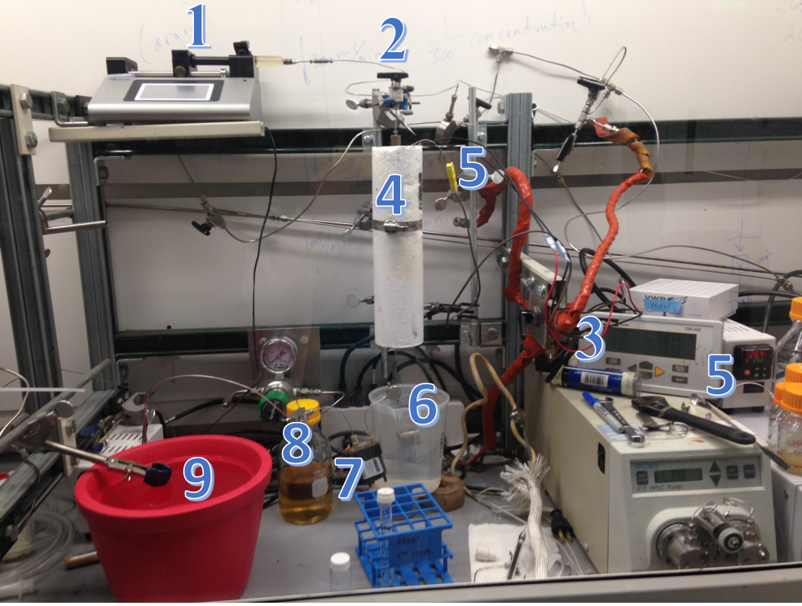
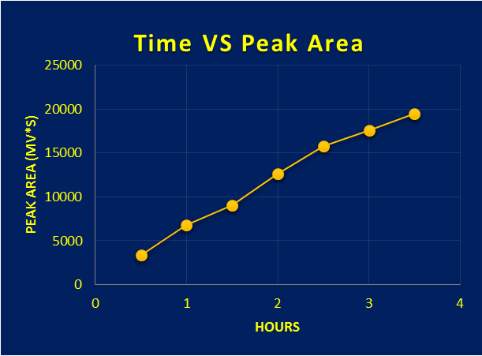
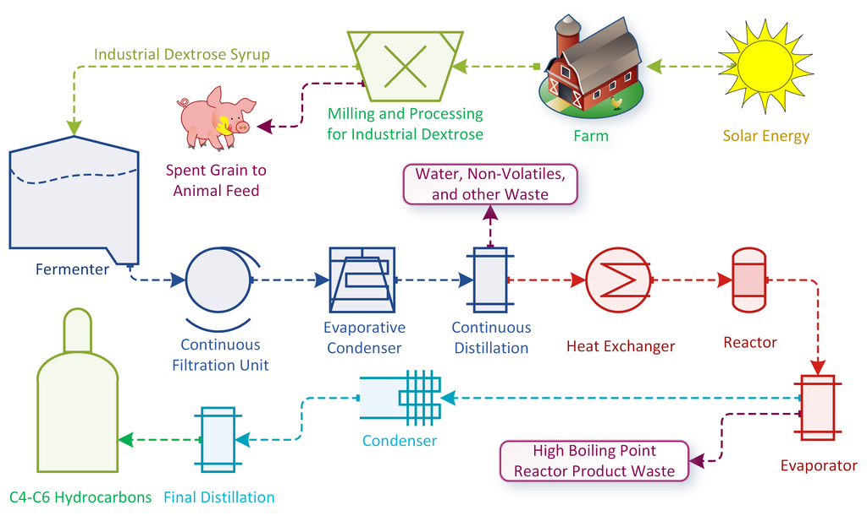
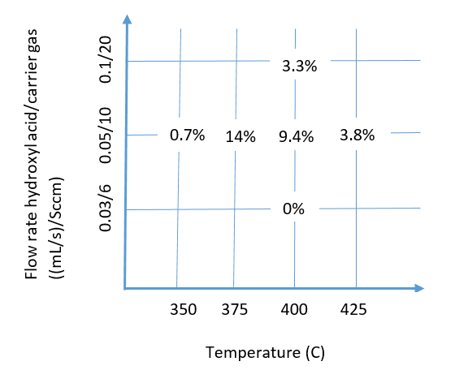

Optimization of Thermochemical Reactions for Eco-friendly Plastic Materials Production
Zeyan Xu¹, Brian Neltner², Deepak Dugar²
¹University of Texas at Dallas, ²Lawrence Berkeley National Laboratory
ABSTRACT
REACTOR DESIGN
KETONE OPTIMIZATION
The manufacturing process of plastics, one
of the most widely used materials in the society, has raised concerns due to its high power driven distillation process and large amount of CO₂ emission as a byproduct.
Visolis Inc., one of the Cyclotron Road projects, solves the issues via a bio-thermochemical engineering process. This project consists of a series of optimization experiments to maximize the yield of the desired plastic materials.
Plastic materials are used extensively in society for their light-weight, corrosion resisting, insulating and other desirable properties. However the production process is both energy inefficient and the large amount of CO₂ it produces which is harmful to the atmosphere in the long run. Thus an energy-efficient, eco-friendly method needs to be developed for an ideal production process.
Fig. 1 Visolis process
The idea of Visolis is to use bio-derived sugar to produce a hydroxyl-acid, and make plastics from the hydroxyl-acid via a high temperature catalysis process. This project studies and optimizes the production of two key plastics materials: a diene and a ketone chemical. Products are analyzed with gas chromatography, mass spectroscopy and high performance liquid chromatography.
However, peak intensity increased as a function of the length of time of reaction:
Another material that Visolis optimize for is a particular ketone material. There are two main parameters to vary:
the temperature of the catalytic process
the flow rate of the hydroxyl acid and the carrier gas (nitrogen)
The results are analyzed with High Performance Liquid Chromatography:
To aid the visualization of the results, data points are plotted in the graph below:
Fig. 5 Plot of yield
Fig. 2 Reactor Setup
1. Programmable syringe pump
2. Mass flow controller
3. 3-way valve
4. Reactor furnace
5. Thermal couple and temperature controller
6. Cooling coil
7. Debubbler
8. Waste bottle
9. Dodecane trap
Temperature (C) | Flow rate Reactant (mm/s) | Flow rate N2 (sccm) | Peak area (average) (mV*s) | Yield (average) (%)
400 | 0.05 | 10 | 79151 | 9.4
425 | 0.05 | 10 | 63742 | 3.8
375 | 0.05 | 10 | 236831 | 14
400 | 0.1 | 20 | 56622 | 3.3
400 | 0.03 | 6 | 59.4 | 0
350 | 0.05 | 10 | 12109 | 0.7
INTRODUCTION
Fig. 6 peak area increase over time
To eliminate variability, new sets of experiments were designed to run overnight with 15+ hours between starting the reaction and collecting samples.
Temperature (C) | Flow rate Reactant (mm/s) | Flow rate N2 (sccm) | Peak area (average) (mV*s) | Yield (average) (%)
375 | 0.05 | 10 | 248871 | 14.7
375 | 0.1 | 20 | 120197 | 7.1
350 | 0.05 | 10 | 215923 | 12.8
DIENE OPTIMIZATION
The Visolis process aims to maximize the yield of a particular diene material as it is crucial role in elastomer applications.
The temperatures of the reactions are varied, results are collected and analyzed with gas chromatography (GC).
Fig. 4 Ketone results, with highest yield of 14%
Fig. 7 Ketone results with longer time
Waiting longer time shows less variability as well as better yield of the product.
ACKNOWLEDGMENTS
Temperature (C) | Peak Area (V*s) | Yield (%)
200 | 0.527 | 45.51
250 | 1.169 | 89.1
300 | 0.527 | 45
This work was supported in part by the U.S. Department of Energy, Office of Science, Office of Workforce Development for Teachers and Scientists (WDTS) under the Science Undergraduate Laboratory Internship (SULI) program. The author would like to thank her associate mentor Dr. Brian Neltner, and mentor Dr. Deepak Dugar, as well as Prof. Toste’s group at UC Berkeley for being very accessible and supportive.
Fig. 3 Diene results. The highest yield occurred at 250C.

