Slide 1


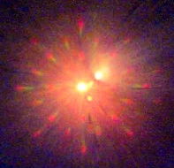
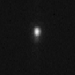
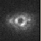
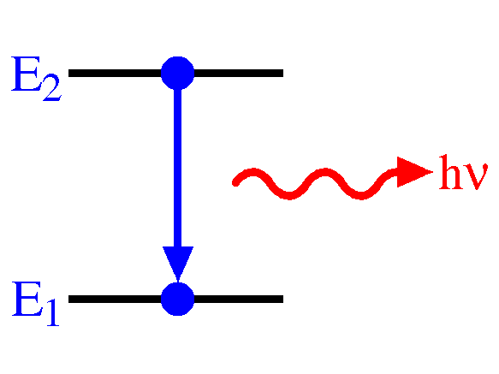
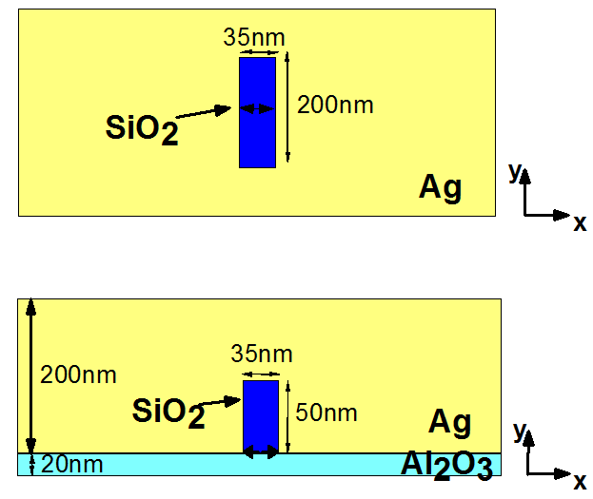
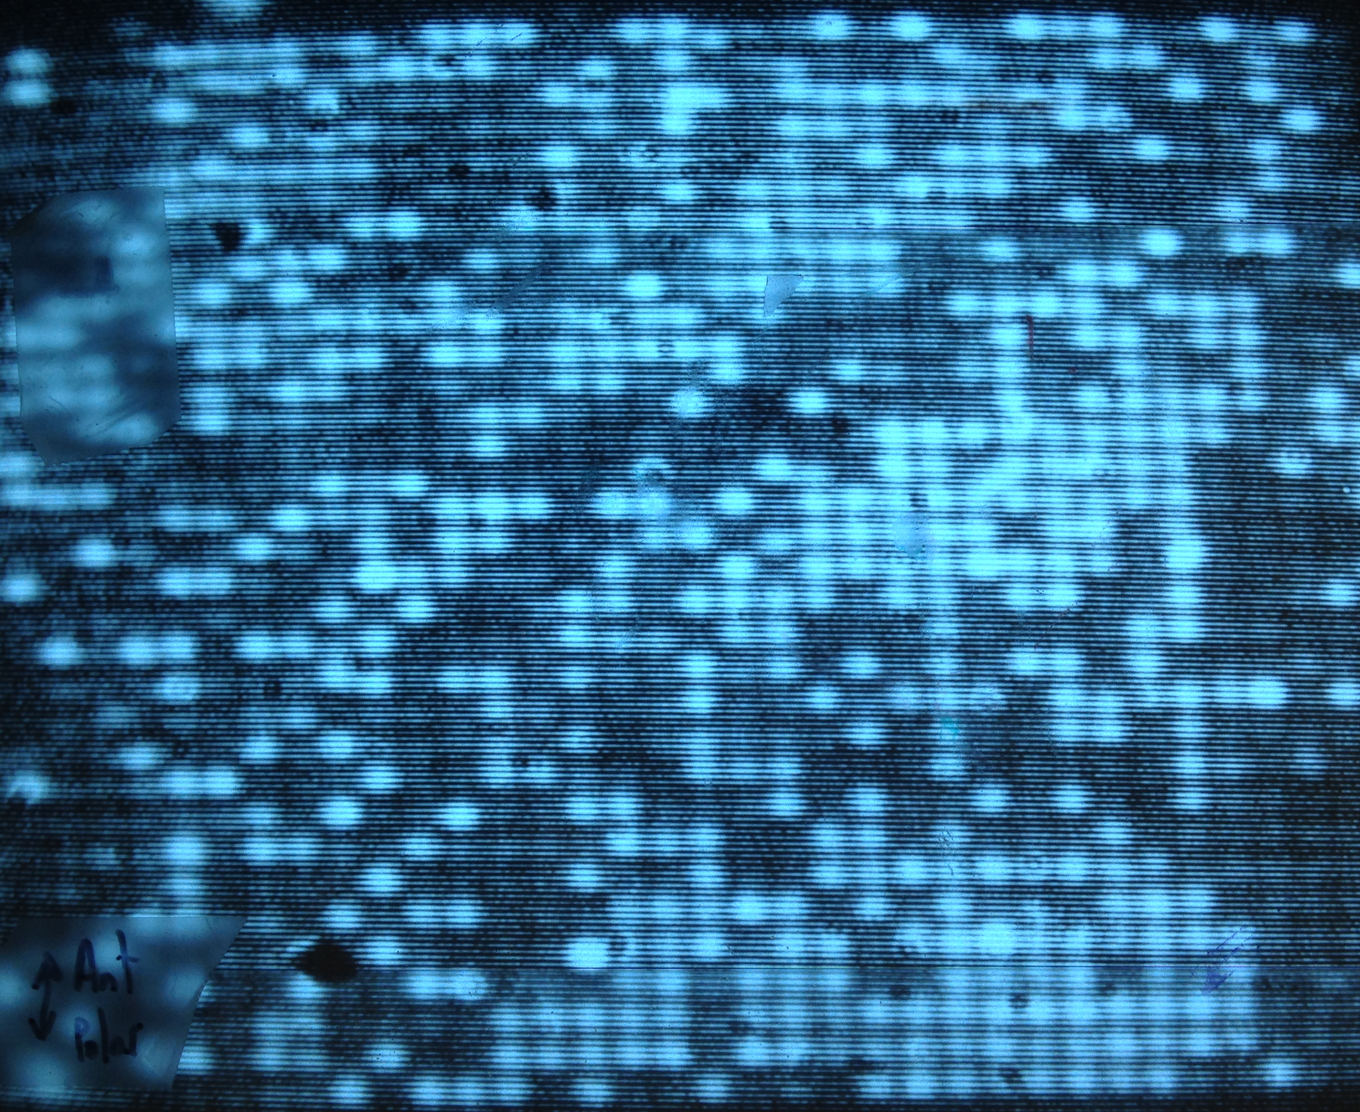
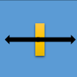
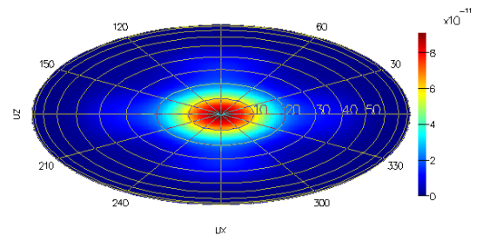
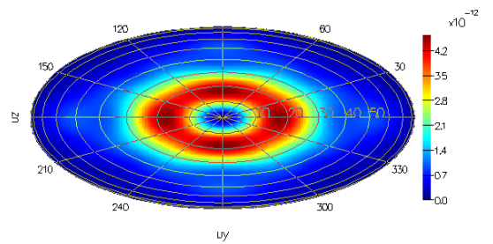
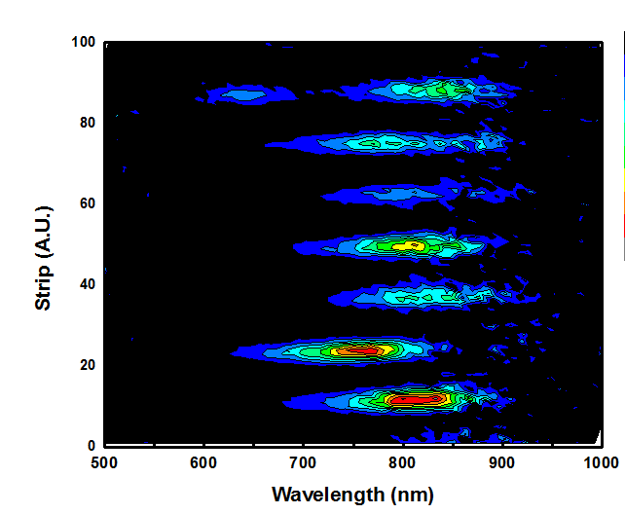
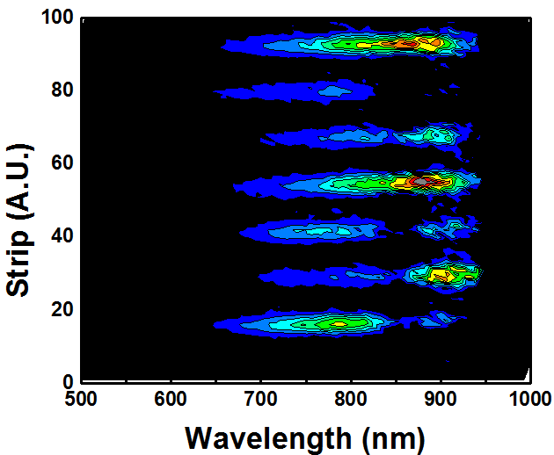
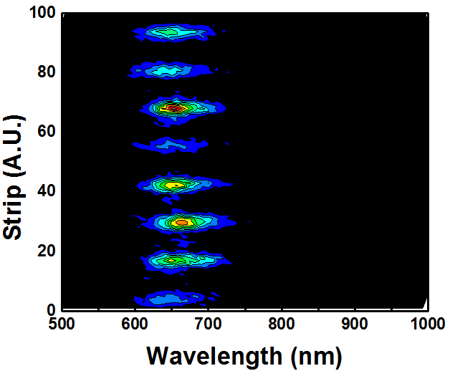
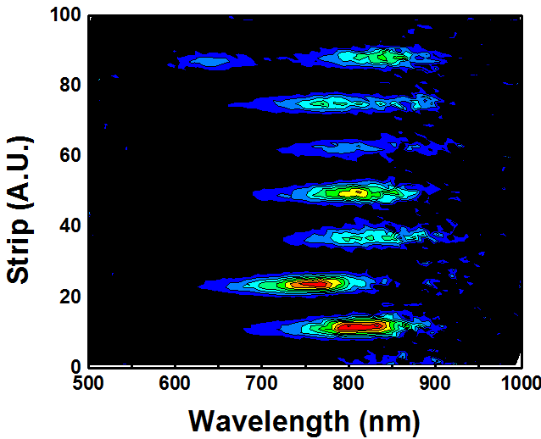
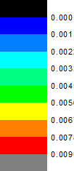
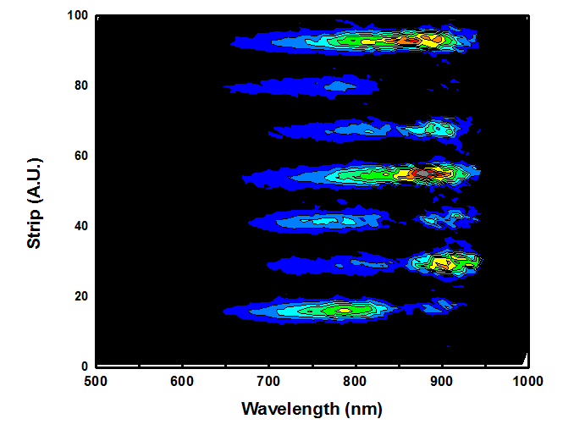
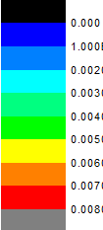
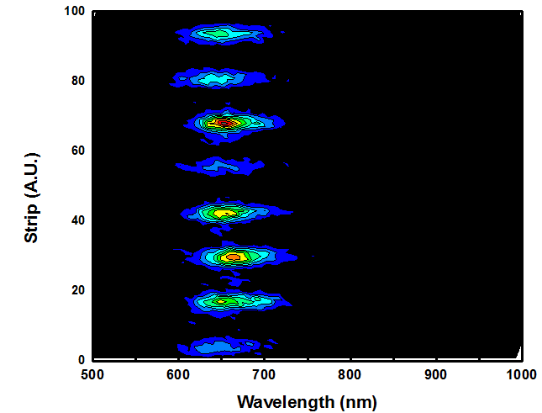
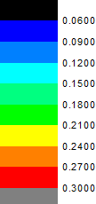
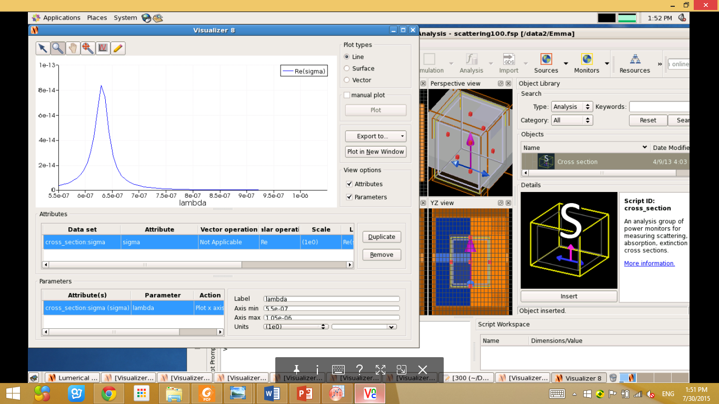
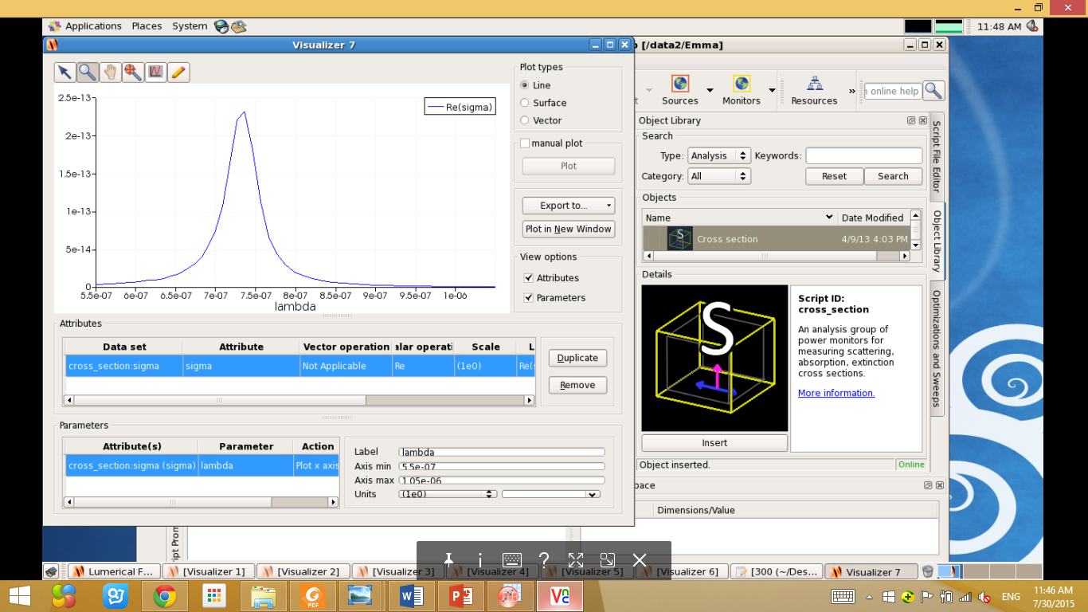
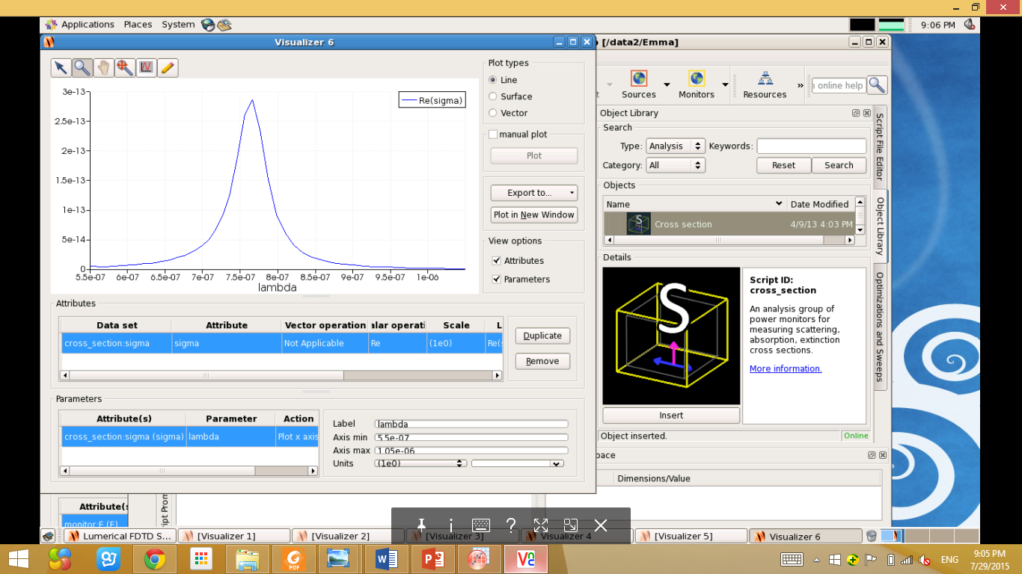

Center for Energy Efficient Electronics Science
A National Science Foundation Science & Technology Center
Radiation Pattern and Scattering
Properties of Ag Optical Antennas
Zeyan Xu¹, Kevin Messer², and Eli Yablonovitch²
¹University of Texas at Dallas, ²University of California, Berkeley
Abstract: When light emitting devices (e.g. LEDs) are coupled to optical antennas of the same resonance frequency, their spontaneous emission rate can be enhanced drastically. The ultimate goal is to have the rate of spontaneous emission faster than the stimulated emission so that the LEDs would be as fast as lasers and enable us to achieve energy efficient interconnects for on-chip communication. [1] In this project, we theoretically and experimentally measured the far field radiation pattern, light scattering properties and photoluminescence of a series of as-fabricated optical antennas. These measurements enabled us to characterize and better understand fundamental behaviors of optical antennas.
Introduction
Far Field Radiation Pattern
Optical antennas are the nanometer scale analog of radio-wave antennas. Their functionalities
are the same: to convert free space electromagnetic energy into localized energy. [2]
Optical antennas can potentially make LEDs’ spontaneous emission faster.
Using LEDs for optical interconnects could lead to large energy savings in computing.
Experiments:
Simulations:
Back focal
plane image of
a 2D grating
Image of
an optical
antenna
Radiation
pattern of
antenna
Structure:
Y and Z normal
X normal
Figure 1: graph demonstration
of spontaneous emission. Optical
antennas can help make all energy
transitions happen at the same
energies. [3]
Figure 2: schematic of a single
optical antenna from the arrayed
sample. The longitudinal length
are being varied: 100 nm, 200nm,
and 250 nm.
Figure 3: a dark field image
obtained from an array of optical
antennas. The variations in
brightness are caused by defects.
Antenna
Dipole
y
x
Optical Setup
z
Conclusion/Future Work
Scattering: Far field:
We observe that the wavelength of emission of optical antennas are dependent on its longitudinal length. The longer the antennas, the longer the wavelength of emission is, thus, shorter the resonance frequency. Knowing how the frequency is correlated to the length is important information when it comes to antenna design.
We observe that the simulations and experiments of the far field radiation pattern of the optical antennas agree. Knowing this, the next step is to try different geometries of antennas and see how that changes the radiation pattern. Being able to control the radiation pattern is a key factor in antenna design.
In the future, it is important to do photoluminescence experiments to quantify the exact enhancement we get for having those antennas compared to without them.
sample
CCD
objective
Power-meter
Bertrand lens
Dark field
beam splitter
Laser
Source
Eye piece
filter
Tube lens
pinhole
White light
source
CCD
objective
sample
(Conoscope: image the back focal plane [4])
Scattering
Reference
[1] Novotny, L. & van Hulst, N. Antennas for light. Nature Photon. 5, 83–90 (2011).
[2] Eggleston, Michael S., et al. "Optical antenna enhanced spontaneous emission." Proceedings of the National Academy of Sciences 112.6 (2015): 1704-1709.
[3] Chemical Sciences: A Manual for CSIR-UGC National Eligibility Test for Lectureship and JRF/Atomic spectral line. En.Wikibook.org.
[4] Van Stryland, E., D. Williams, and W. Wolfe. Handbook of optics. Ed. Michael Bass. McGraw-Hill, 1996.
Acknowledgements
The author would like to thank her Principal Investigator, Prof. Eli Yablonovitch for guidance, mentor Kevin Messer for technical help and Andy Michaels for help with simulations. The author would also like to thank Ms. Lea Marlor, James and Fanny for making this program and the summer enjoyable.
Longitudinal lengths: Experiments:
100 nm 200 nm 250 nm
Simulations:
766 nm
630 nm
736 nm
Optical Power (Watts)
Optical Power (Watts)
Optical Power (Watts)
Contact Information
Zeyan Xu
zxx120730@utdallas.edu
Support Information
This work was funded by National Science Foundation Award ECCS-0939514.
Wavelength (nm)
Wavelength (nm)
Wavelength (nm)

